Slide 1
Bus ticket booking
By,
Suryaprakash N,
2021309041,
Department of Textile Technology
ACT campus, Anna University

Slide 2
OUTLINE
Problem Statement
Proposed System/Solution
System Development Approach
Algorithm & Deployment
Result
Conclusion
Future Scope
References

Slide 3
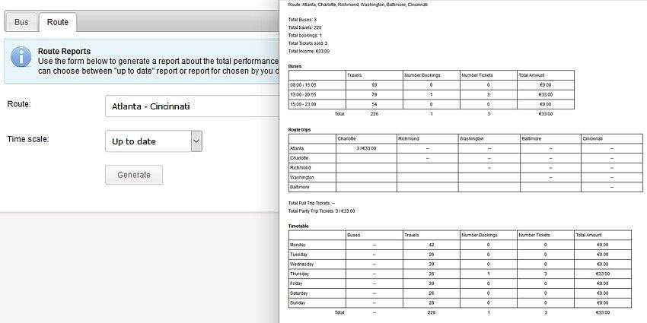
PROBLEM STATEMENT
Unfriendly booking platforms: Confusing interfaces, unclear information about bus amenities or hidden fees can make booking frustrating.

Slide 4
PROPOSED SOLUTION
For unfriendly booking platforms with confusing interfaces and unclear information:
Improved User Interface (UI) and User Experience (UX) Design:
Bus booking platforms should prioritize user-friendly interfaces that are clear, concise, and easy to navigate. This includes intuitive layouts, proper labelling of buttons and features, and minimal clutter.
Transparent Information Display:
All information about the bus journey, including amenities, pricing structure (including any hidden fees), and cancellation policies, should be displayed in a clear, easy-to-find manner.
Use clear and concise language that avoids technical jargon.
Consider using icons or visuals to enhance clarity.
Incorporation of Tooltips and Help Sections:
For any features that might not be self-explanatory, implement tooltips that provide brief descriptions upon hovering.
Additionally, a comprehensive Help section with FAQs (Frequently Asked Questions) can address common user queries and offer step-by-step guides for booking.

Slide 5
SYSTEM APPROACH
To implementing the solutions for unfriendly bus booking platforms:
1. Define Scope and Stakeholders:
Scope: Clearly define the project's goal - improve the UI/UX of the booking platform to address user frustrations related to confusing interfaces and unclear information.
Stakeholders: Identify all parties involved. This includes internal stakeholders like developers, UI/UX designers, content creators, and testers; as well as external stakeholders - passengers (users) and bus operators (if the platform aggregates multiple companies).
2. User Research and Analysis:
Conduct user research (surveys, interviews, usability testing) to understand user pain points and gather feedback on existing interface issues.
Analyze the data to identify the most significant problems regarding confusing layouts, unclear information, and hidden fees.

Slide 6
3. Information Architecture and Design:
Develop a clear information architecture that organizes bus journey details (amenities, pricing, policies) in a logical and user-friendly way.
Design a user interface that is intuitive, visually appealing, and easy to navigate. Prioritize functionalities like clear labelling, appropriate use of white space, and consistent design elements.
4. Content Strategy:
Craft clear and concise content for the platform, avoiding technical jargon. This includes descriptions of bus amenities, pricing breakdowns (highlighting any fees), and cancellation policies.
Consider using icons or visuals to enhance clarity, especially for non-textual information.
5. Implementation and Testing:
Develop the improved UI/UX based on the design and content strategy.
Conduct internal testing to ensure functionality and identify any bugs.
Perform usability testing with real users to gather feedback on the redesigned platform and iterate based on their experience.
6. Deployment and Maintenance:
Launch the improved platform with clear communication to users about the changes.
Establish a system for ongoing monitoring and feedback collection.
Regularly review user feedback and make adjustments to the platform as needed. This could involve adding tooltips, refining content, or addressing new user pain points.

Slide 7
ALGORITHM AND DEVELOPMENT
The focus is on good design principles and clear presentation of information.
The breakdown of the development approach, focusing on the user interface and information display:
Development Approach:
Front-End Development: This involves building the user interface using web development technologies like HTML, CSS, and Javascript frameworks (e.g., React, Angular).
The code will focus on creating a clear layout, implementing intuitive navigation elements (buttons, menus), and ensuring responsiveness across different devices (desktop, mobile).
Content Management System (CMS) Integration: A CMS allows for easy editing and updating of bus information, amenities lists, pricing structures, and policies. This empowers the platform to maintain accurate and up-to-date information without requiring extensive code changes.

Slide 8
Information Display Techniques:
Data Visualization: Consider using icons or pictograms to represent amenities (Wi-Fi, washroom, legroom) for quicker comprehension.
Interactive Elements: Implement features like hover-over tooltips that provide detailed descriptions of bus features or hidden fees associated with specific fare options.
Accordion Menus: Organize information like detailed pricing breakdowns or cancellation policies within accordion menus, allowing users to expand sections they need while maintaining a clean, uncluttered interface.
Additional Considerations:
Accessibility: Ensure the platform adheres to web accessibility standards, making it usable for people with disabilities (e.g., screen reader compatibility, proper color contrast).
Multilingual Support: If the platform caters to a diverse audience, consider implementing multi-language functionality to improve user experience for non-native speakers.

Slide 9
RESULT
The outcome of implementing the aforementioned solutions would be a significant improvement in the user experience of the bus booking platform. Here are some of the anticipated results:
Increased User Satisfaction: A user-friendly interface with clear information will make the booking process smoother and less frustrating for passengers.
Reduced Booking Errors: Transparent information about amenities, pricing, and fees will lead to fewer misunderstandings and incorrect bookings.
Improved Operational Efficiency: A well-designed platform can streamline the booking process, potentially reducing customer support queries related to unclear information.
Enhanced Brand Image: A platform that prioritizes user experience can foster customer loyalty and attract new users seeking a convenient and hassle-free booking experience.

Slide 10
CONCLUSION
The unfriendly booking platforms with confusing interfaces and unclear information can be a major hurdle for bus passengers.
However, by implementing a systematic approach that prioritizes user experience (UX) design and clear information architecture, significant improvements can be made.
This includes developing a user-friendly interface, crafting clear and concise content, and utilizing effective information display techniques.
The result of these efforts should be a booking platform that is intuitive, easy to navigate, and provides all necessary details about bus journeys upfront.
This will lead to increased user satisfaction, fewer booking errors, and a more positive brand image for the platform.
Ultimately, by focusing on user needs, bus booking platforms can create a smoother and more enjoyable experience for passengers.

Slide 11
FUTURE SCOPE
The future scope for improving bus booking platforms extends beyond addressing unfriendly interfaces and unclear information. Here are some exciting possibilities:
Integration with Mobility Platforms: Imagine seamless integration with ride-hailing apps or public transport ticketing systems. This would allow users to book first-mile/last-mile connectivity (e.g., cabs, local buses) along with their intercity bus tickets, creating a more holistic travel booking experience.
Real-Time Tracking and Information: Live bus tracking features would be a game-changer. Passengers could see their bus location, estimated arrival time, and even any potential delays in real-time. This would significantly enhance convenience and reduce travel anxiety.

Slide 12
Personalized Recommendations and Offers: By leveraging user data and travel patterns, platforms could offer personalized recommendations for routes, stopovers, and even bundled deals with hotels or activities at the destination. This could create a more engaging user experience and potentially increase ancillary revenue for the platform.
Voice Search and Chatbot Integration: Voice search functionality would allow users to make quick bookings using voice commands. Additionally, integrating chatbots with AI capabilities could provide 24/7 customer support, answer user queries about routes and amenities, and even handle basic booking modifications.
Focus on Sustainability: Platforms could highlight eco-friendly options like electric buses or carbon offset programs, allowing passengers to make sustainable travel choices. Integrating with carbon footprint calculators could further enhance this aspect.

Slide 13
REFERENCES
Nielsen Norman Group (NN/g): https://www.nngroup.com/ - A well-respected authority on UX research, usability, and web design. Their website offers a wealth of articles and resources on best practices for designing user-friendly interfaces.
World Wide Web Consortium (W3C) Web Accessibility Initiative (WAI): https://www.w3.org/WAI/ - Provides guidelines and standards for developing web content that is accessible to people with disabilities.
Microsoft Design: https://designer.microsoft.com/ - Offers resources on UX design principles, including user research, information architecture, and interaction design.

Slide 14
THANK YOU

